Slide 1

Forecasting Nifty 200 data utilizing the preceding year’s data with the assistance of PySpark and Airflow
Guided by:
Presented by:
Prof. Divya Das
Akhil Janardhanan (250860925001)
Prof. Soorya Mam
Dhruvin Solanki (250860925007)
Jahanvi Malviya (250860925004)
Sagar Chavan (250860925006)

Slide 2

Problem Statement
Financial markets generate massive volumes of time-series data characterized by high volatility and inherent analytical complexity. Traditional tools often struggle to process this scale and nature of data effectively.
Manual analysis of stock index trends is not only time-consuming and prone to human error but also lacks the scalability required for modern financial applications.
Project Objective:
To develop a robust system for forecasting the Nifty 200 stock index using previous year's historical data. This involves leveraging PySpark for distributed data processing and Apache Airflow for automated workflow orchestration, ensuring a scalable, reliable, and repeatable market trend forecasting solution.

Slide 3




Why This Project?
Strategic Investment Decisions
Overcoming Data Challenges
Accurate stock market forecasting is critical for informed investment strategies and proactive risk management in dynamic financial landscapes.
Traditional single-machine processing units are inadequate for the sheer volume and velocity of modern financial datasets, necessitating distributed solutions.
Automation & Reliability
Leveraging PySpark & Airflow
There is a pressing need for automated, scalable, and highly reliable analytical pipelines in financial operations to ensure consistent performance.
PySpark provides the backbone for distributed computation on large datasets, while Airflow guarantees end-to-end automation and seamless scheduling of complex forecasting workflows.

Slide 4
Key Objectives
Efficient Data Analysis
1
To effectively analyze historical Nifty 200 index data, extracting meaningful patterns and trends.
Scalable Pipeline Development
2
To construct a robust and scalable forecasting pipeline utilizing the distributed processing capabilities of PySpark.
Automated Workflow Integration
3
To automate data ingestion, processing, and forecasting operations through Apache Airflow for reliability and repeatability.
Accuracy Evaluation
4
To rigorously evaluate the forecasting model's accuracy using established statistical metrics.
Actionable Insights Generation
5
To produce timely and actionable insights that can inform short-term market trend predictions.

Slide 5
Dataset Overview
Dataset Description
Key Attributes Included:
Date: The specific trading day.
Consists of historical Nifty 200 index data.
Stock Symbol: Unique identifier for each stock.
Captures daily stock closing prices for Nifty 200 constituent stocks.
Closing Price: The final trading price for the day.
Data duration: Comprehensive historical market data spanning the previous one year.
Opening Price: The price at the start of the trading day.
Stored in CSV format and efficiently ingested into HDFS.
High Price: The highest price reached during the trading day.
Low Price: The lowest price reached during the trading day.
Volume: The total number of shares traded.
Adjusted Close Price: Closing price adjusted for corporate actions (splits/dividends)

Slide 6
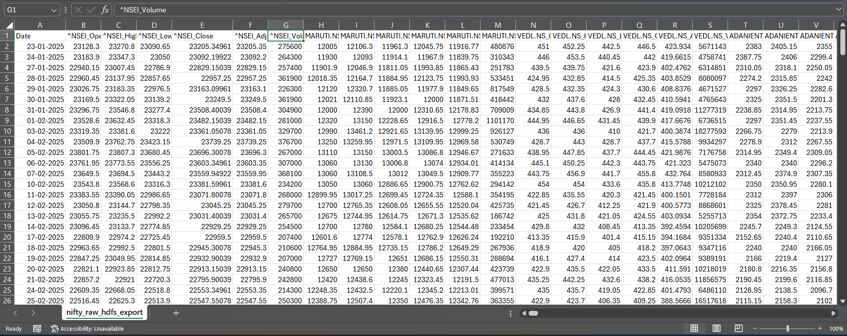

Slide 7







Core Technologies: The Pillars of Our Forecasting System
PySpark
Apache Airflow
HDFS
Utilized for distributed data processing and transformation, enabling scalable operations on large datasets.
Employed for robust workflow scheduling and automation, ensuring timely and consistent execution of tasks.
Provided distributed storage for both raw and processed data, supporting fault tolerance and high throughput.
Python
ARIMA (Auto-ARIMA)
Pandas & NumPy
The primary language for data analysis, model development, and scripting various components of the system.
Selected as the core time-series forecasting model for its effectiveness in handling temporal data.
Leveraged for efficient data manipulation and numerical operations, crucial for preparing and processing financial data.
Hive
Data warehousing and SQL-based querying on Nifty 200 historical data

Slide 8





Data Pre-Processing
Data Ingestion
Raw CSV data was loaded directly from HDFS using PySpark, leveraging its distributed capabilities.
Handling Missing Values
Applied robust forward-fill techniques to address and impute any missing data points, ensuring data continuity.
Time-Series Conversion
Date columns were transformed into appropriate time-series formats, crucial for sequential analysis.
Data Filtering & Cleaning
Inconsistent stock entries were meticulously filtered and cleaned to maintain data integrity and accuracy.
Model-Ready Datasets
Structured and refined datasets were prepared, optimizing them for seamless integration into forecasting models.

Slide 9
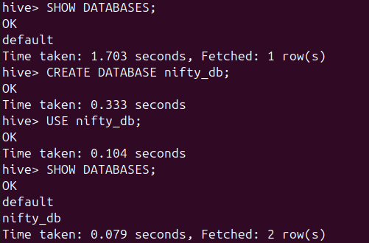
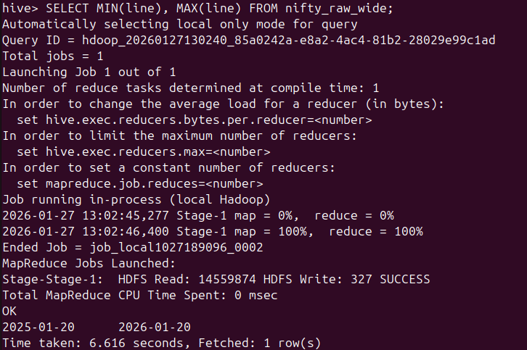
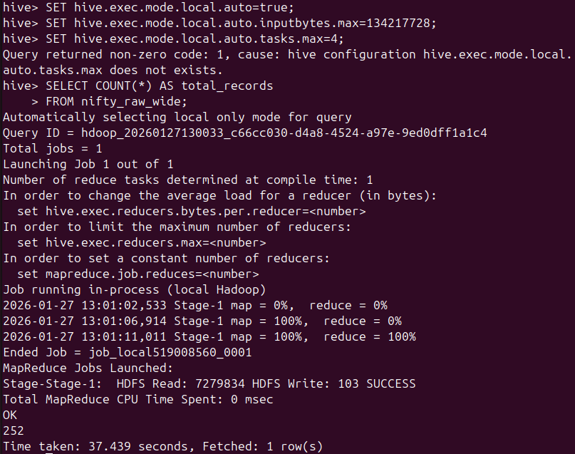
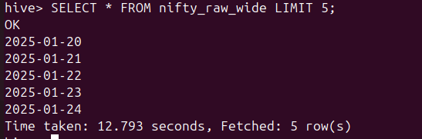
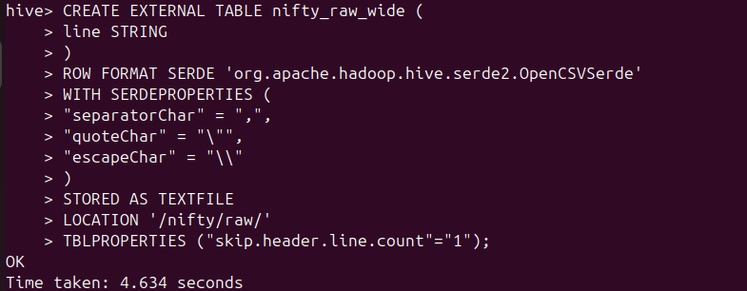

Slide 10
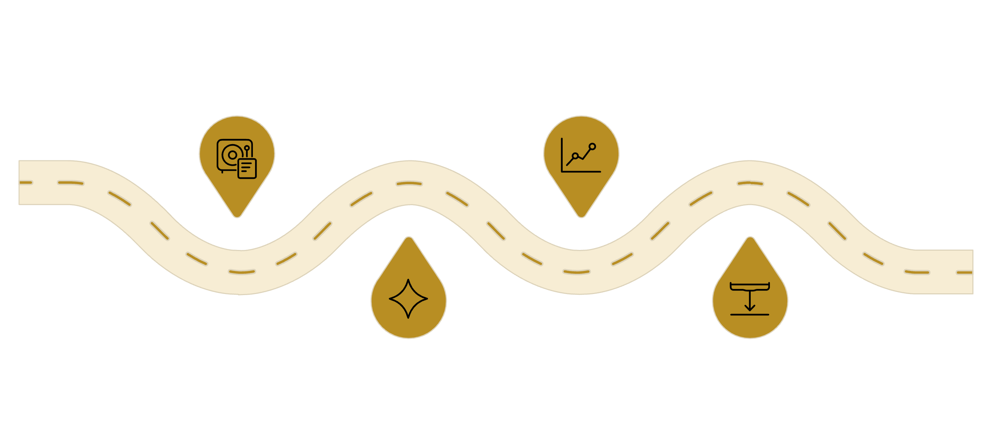

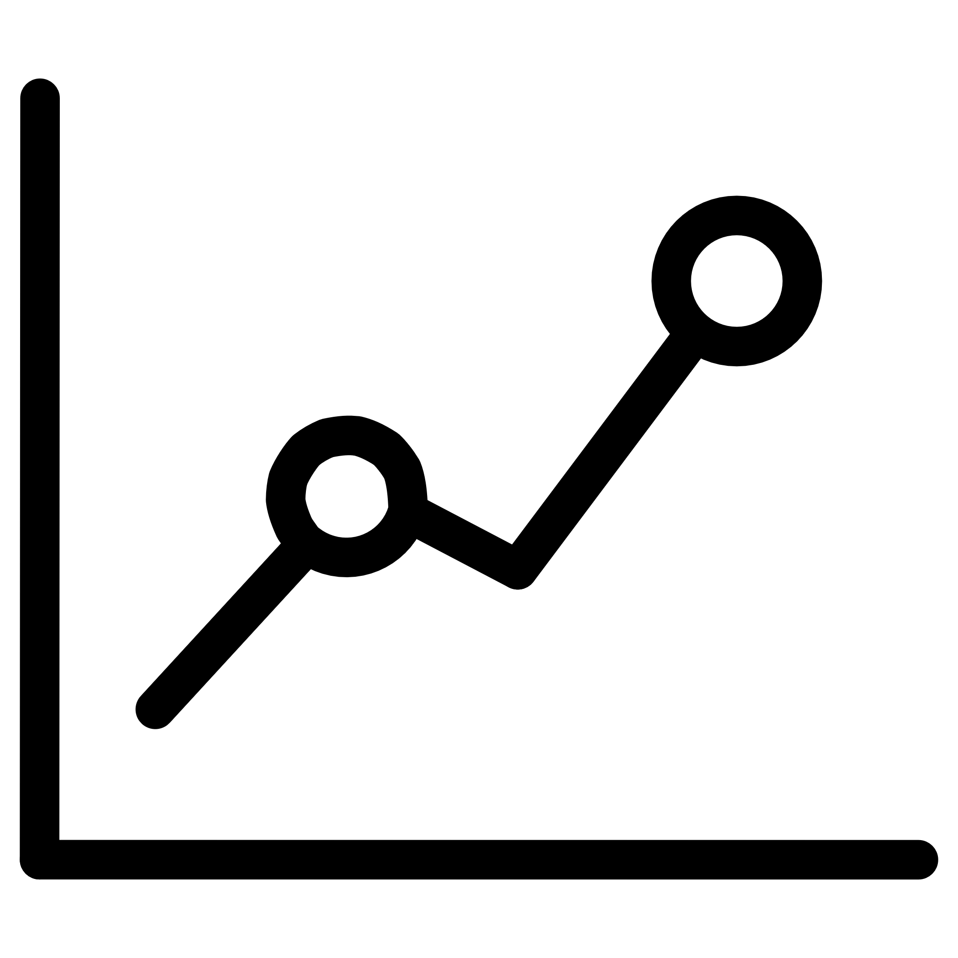


System Architecture: End-to-End Forecasting Pipeline
Our architecture integrates HDFS for storage, Hive for create external tables and perform structured SQL-based analysis, PySpark for processing, and Airflow for orchestration, ensuring a seamless and automated flow from raw data to actionable forecasts.
Raw Nifty Data
Forecast Model
HDFS storage of input files
Apply predictive algorithms
PySpark Processing
Airflow Orchestration
Data cleaning and feature prep
Ingest, run models, store results

Slide 11



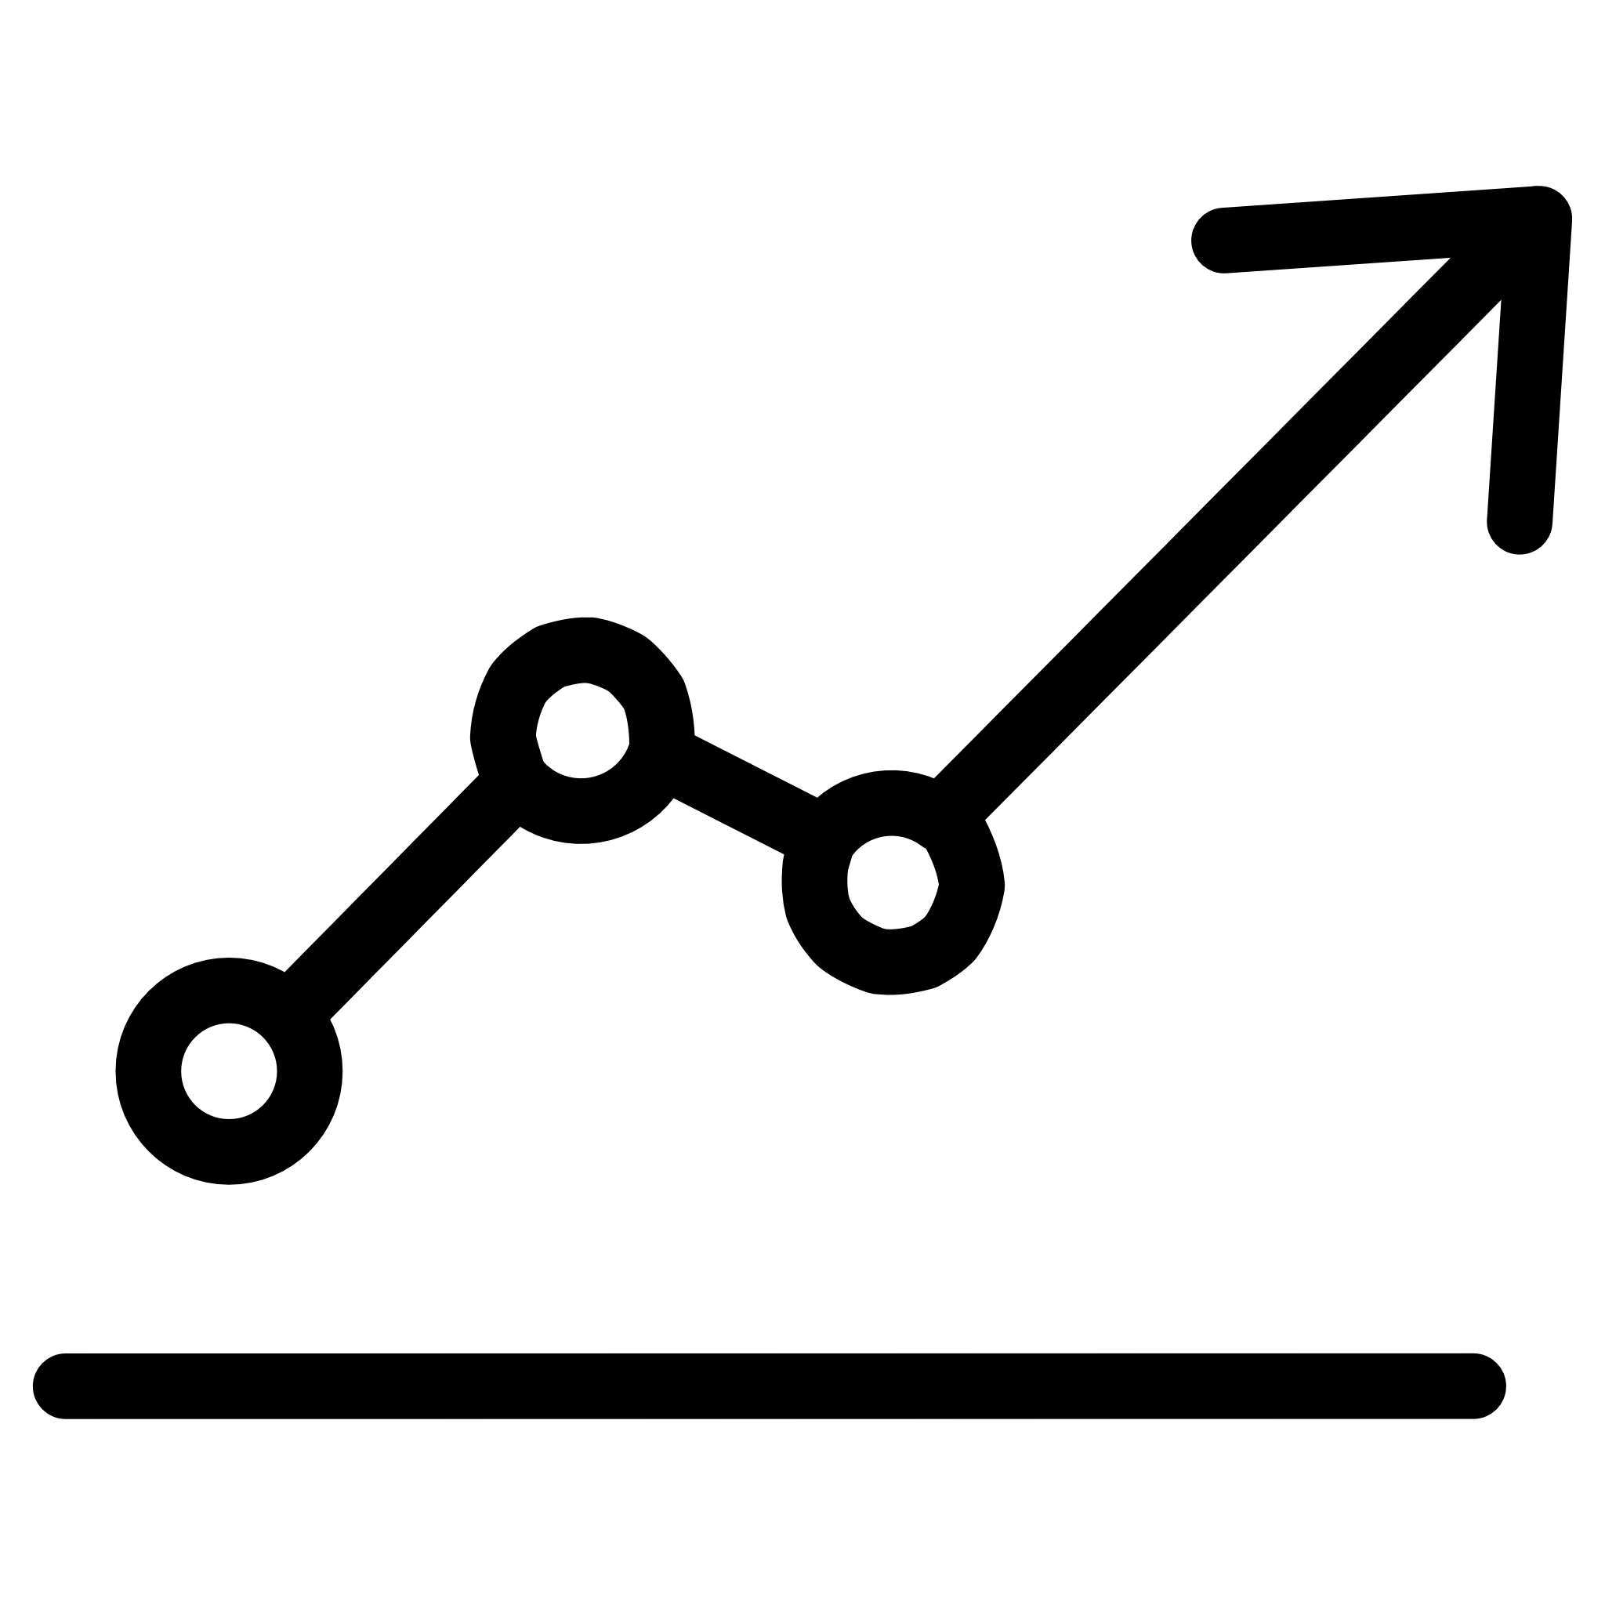
Forecasting Methodology & Model Evaluation
Forecasting Methodology
Model Evaluation: Performance Metrics Used
Auto-ARIMA Model
Employed Auto-ARIMA for robust time-series forecasting, automatically determining optimal model parameters.
MAPE
Accuracy Calculation
Historical Training
Mean Absolute Percentage Error (MAPE) is the primary metric to quantify forecast accuracy.
Forecast Accuracy = (100 - MAPE), providing an intuitive measure of model reliability.
The model was rigorously trained using comprehensive historical closing prices of the Nifty 200 index.
Back-testing
Extensive back-testing was performed on recent data points to validate model performance and stability.
Predicted vs. Actual
Stock-Wise Analysis
Next-Day Prediction
Detailed comparison of predicted values against actual market values to assess deviations.
Individual stock-wise accuracy analysis identifies variations in model performance across different securities.
Forecasts are generated specifically for the next trading day, focusing on short-term predictions.
Trend Direction
Percentage change is calculated to clearly indicate the projected trend direction (up, down, or stable).

Slide 12
Comparative Study

Slide 13
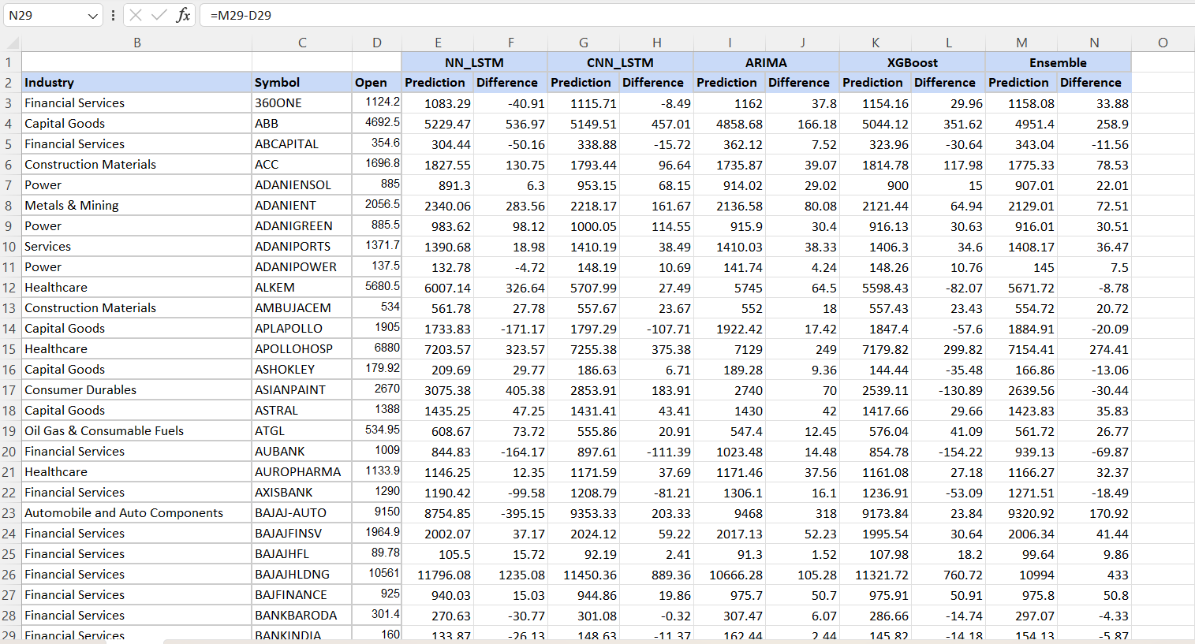

Slide 14
Results & Observations

Slide 15
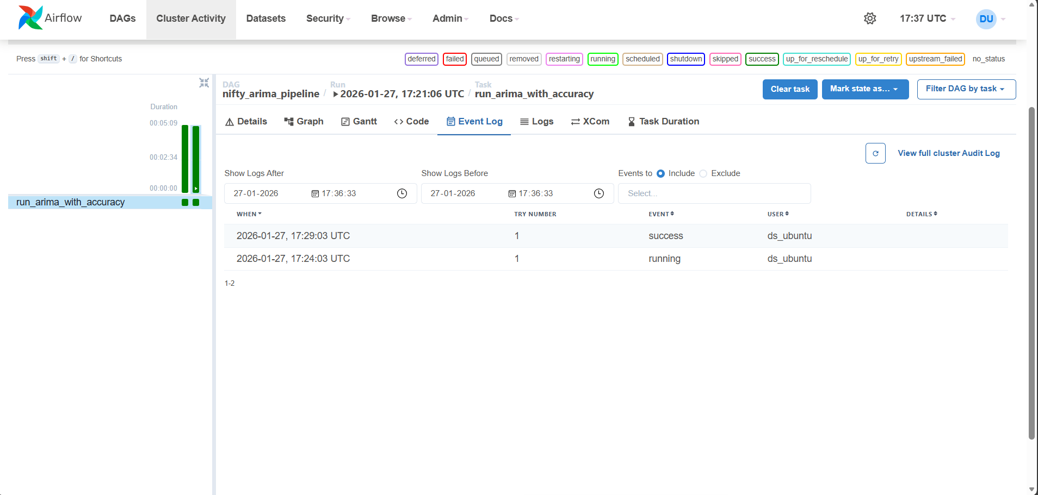

Slide 16
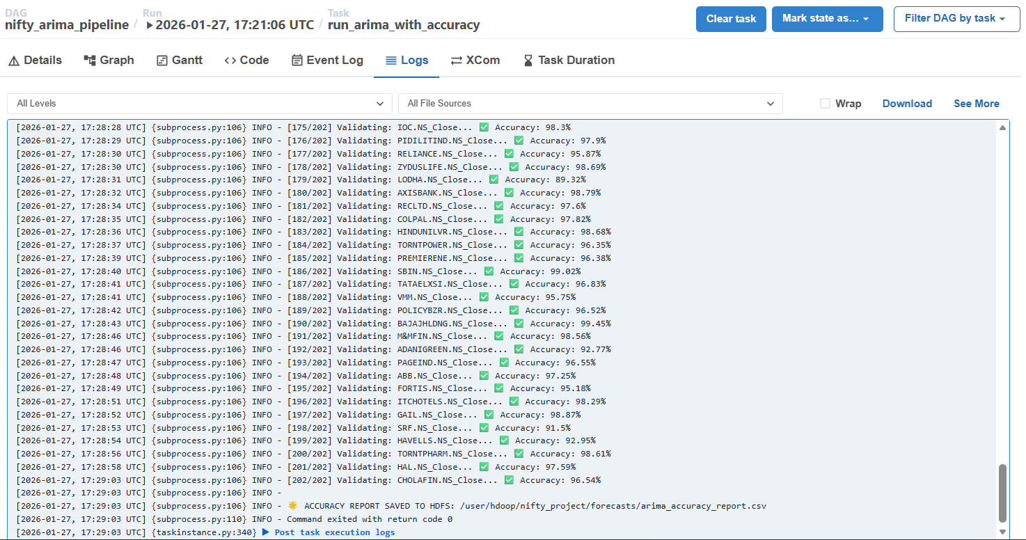

Slide 17
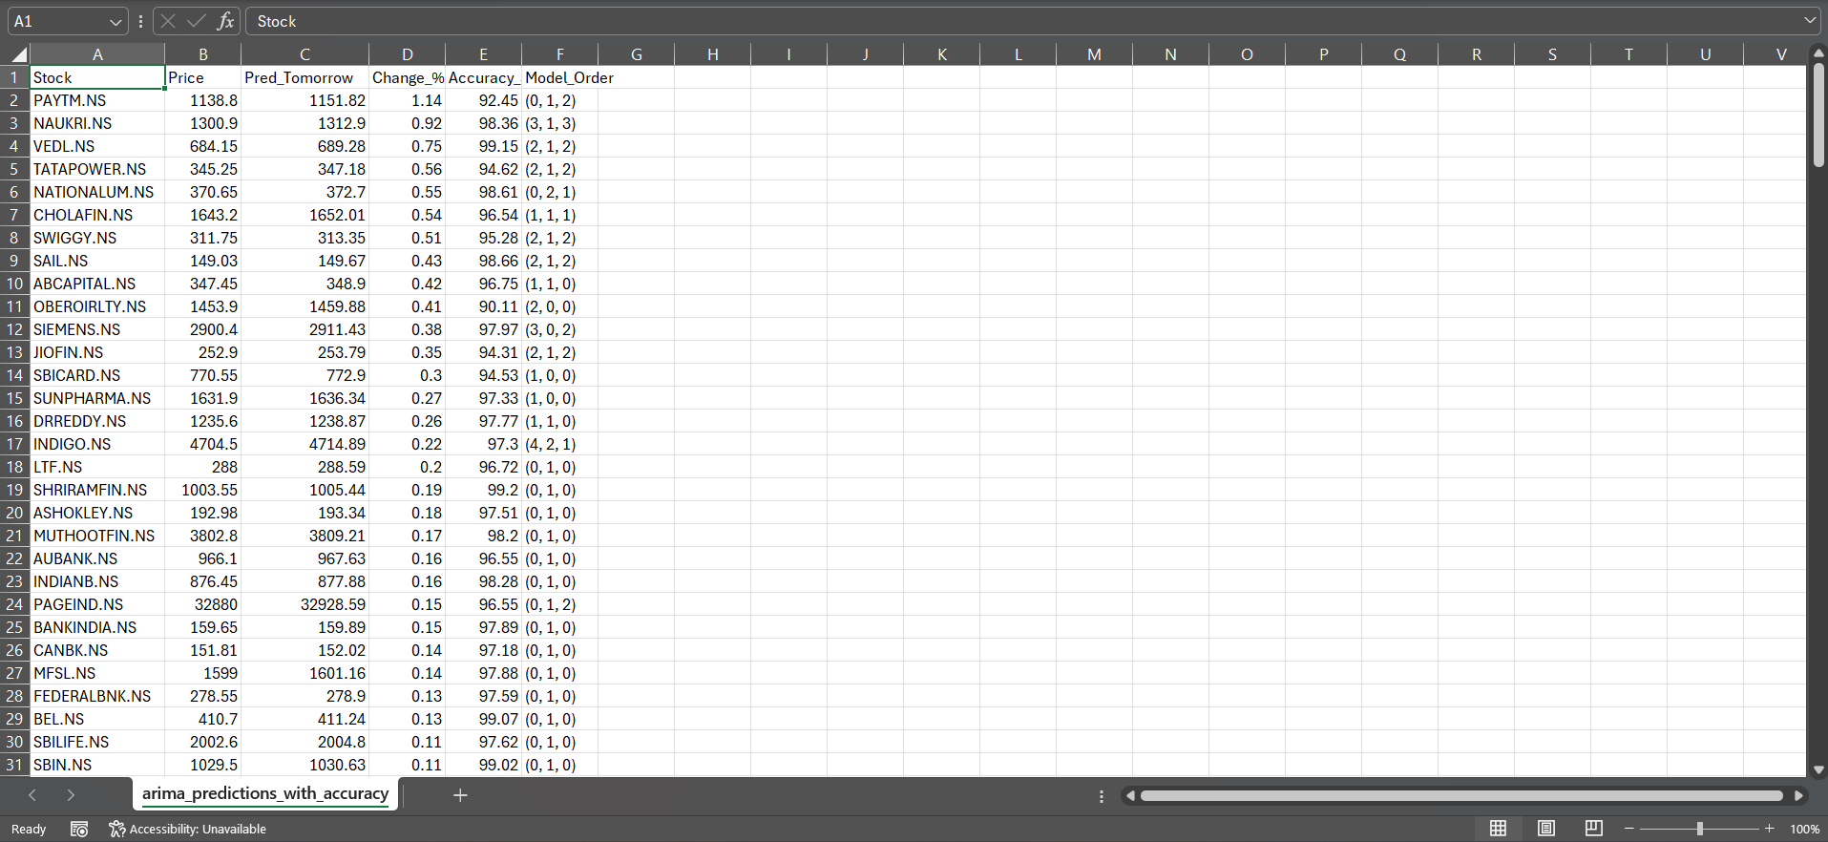

Slide 18
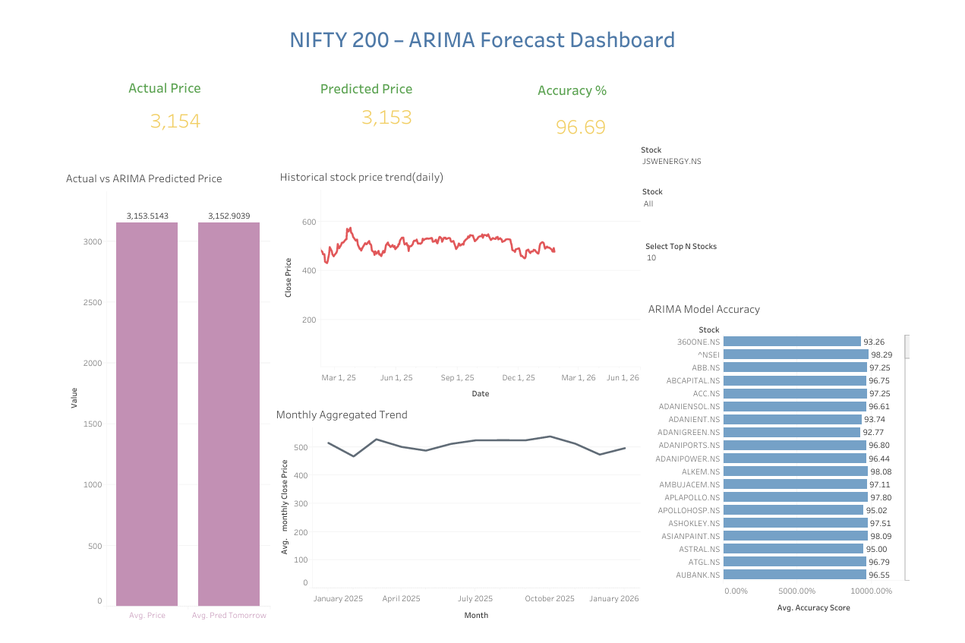

Slide 19
Advantages of the Proposed System
Scalable Processing: Leverages PySpark for scalable big-data processing.
Full Automation: Ensures a fully automated workflow through Airflow.
Efficient Handling: Effectively manages large financial datasets.
Reduced Time: Significantly decreased execution time compared to traditional methods.
Reusable: Offers a reusable and extensible forecasting pipeline.
Limitations
Historical Dependency: Forecast accuracy is inherently dependent on historical trends.
External Factors: Market volatility and unforeseen external factors are not explicitly modeled.
Short-Term Focus: Currently limited to short-term forecasting horizons.
Varying Performance: Model performance may exhibit variations across individual stocks.

Slide 20
Future Scope
Advanced Models: Incorporate deep learning models for enhanced prediction capabilities.
Expanded Indicators: Integrate macro-economic indicators and news sentiment analysis for a holistic view.
Longer Horizon: Extend the forecasting horizon to weekly or monthly predictions.
Real-Time Data: Implement real-time streaming data processing using technologies like Kafka.
Dashboard Integration: Deploy results via interactive dashboards for investors and stakeholders.
Conclusion
We have successfully implemented a scalable stock forecasting system that leverages the power of PySpark for distributed processing and Apache Airflow for robust automation. This project demonstrates an effective, end-to-end solution for financial analytics, suitable for real-world use cases.

Slide 21
Thank You!

